Slide 1
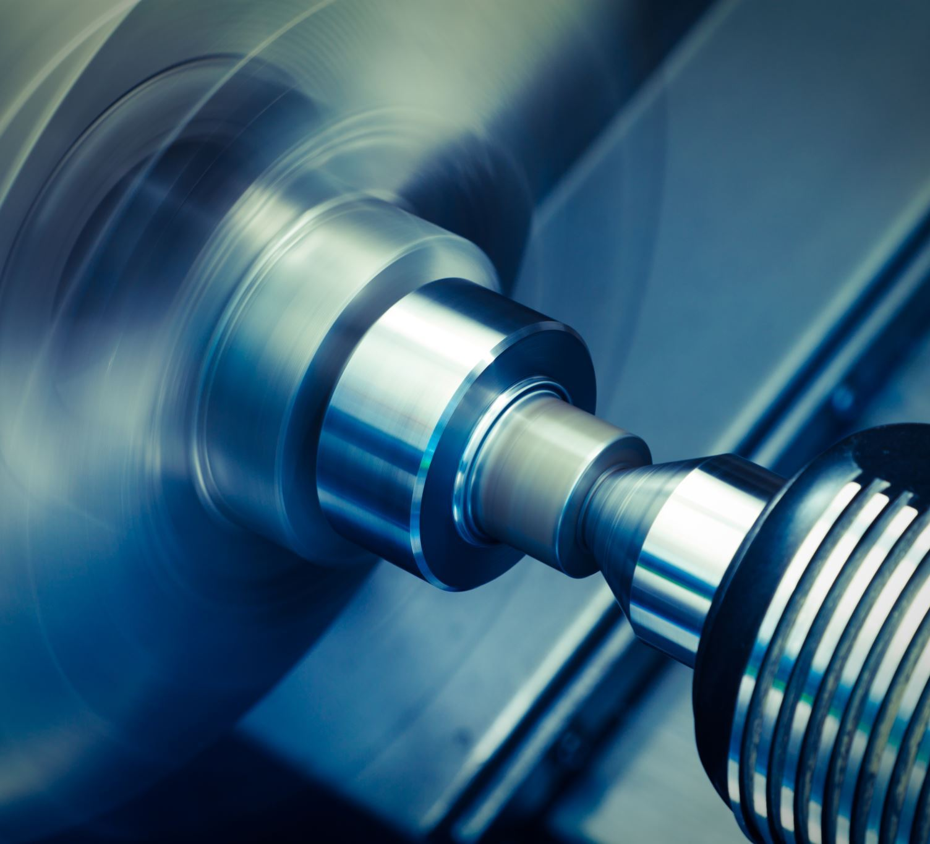
INFLUENCE AND PERSUASION IN Manufacturing INDUSTRY
Lynda Villarreal
Magda Albino
Sreekar Bathula
Ejiofor Chukwuelue
Bartolomeo Magnani

Slide 2

Contents
Manufacturing Industry analysis
Trends and challenges
Addressing the challenges
Cialdini's Principles leveraged in the manufacturing
Principle in recent advert
Conclusions and Recommendations

Slide 3
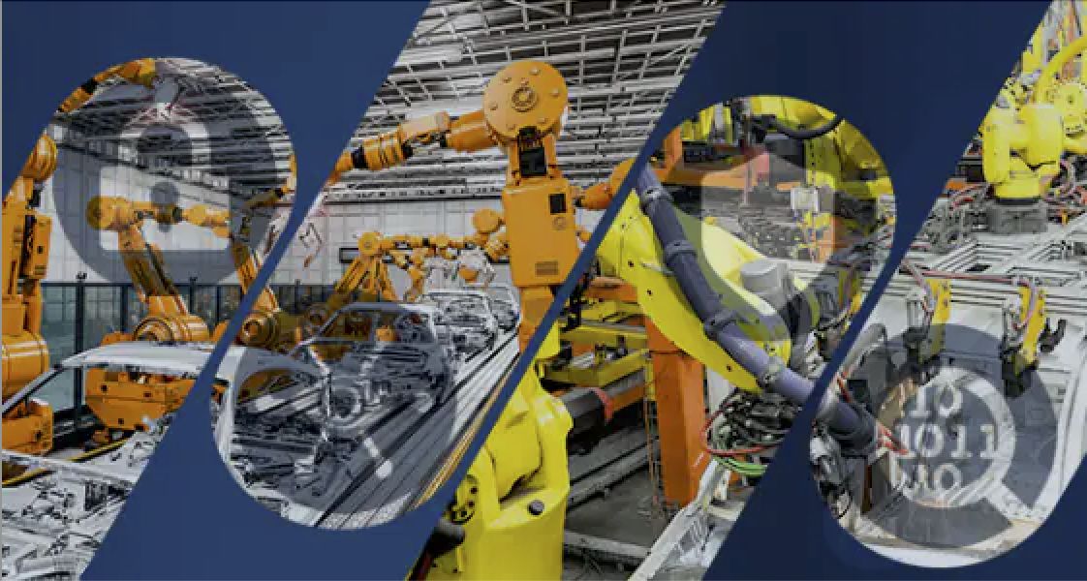
Manufacturing Industry analysis
Structure
Performance
Opportunity
Highly competitive
Technological advancements
Revenue - $7.0 tr
Innovation
Increase efficiency
Profit - $558.4 bn

Slide 4
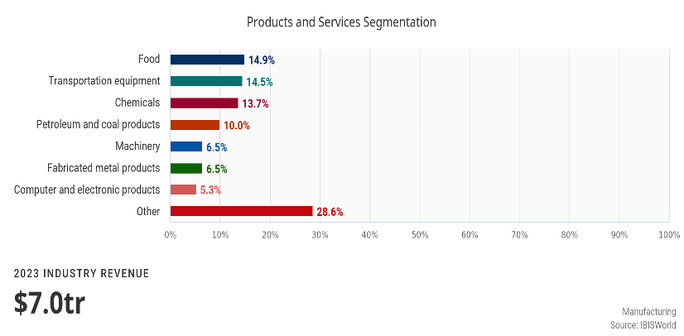

Slide 5
TRENDS and challenges
Automation and digitization.
Attracting and retaining skilled labor.
Resilient supply chain.

Slide 6

addressing the challenges
Invest in Technology and digitization
Supply chain resilience is crucial
Attracting and retaining skilled labour is a significant challenge.

Slide 7


CIALDINI'S PRINCIPLES LEVERAGED IN THE INDUSTRY
Social Proof Influence
Sympathy & Unity
To show examples of competitors
Attracting and retaining skilled talent
Notes:
Consider talking about:
Traditional vs. advanced manufacturers
Successful manufacturers
Research and development

Slide 8


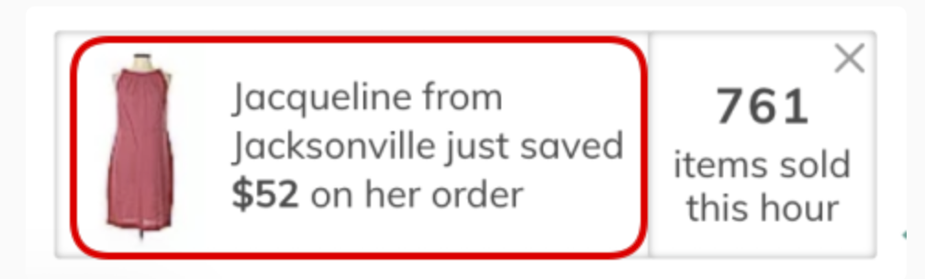
PRINCIPLE IN RECENT ADVERT

Slide 9

Conclusions and recommendations
Manufacturing is facing challenges: Automation, digitization, supply chain, attracting and retaining labor
Industry leaders are using persuasion and influence tactics to address the challenges
Leaders must continue to employ persuasion and influence to improve their performance
Interviewees are using Cialdini’s Principles such as social proof, sympathy and unity

Slide 10

Works cited
KPMG. (2022). Global Manufacturing Prospects 2022.
KPMG. (2023). Global Manufacturing Prospects 2023.
IBISWorld Vlad. (2023).
Manufacturing in the US 2023. Alithya. (2023).
2023 Manufacturing Industry Trends: Survey Results and Analysis. De Backer, G. (2022).
Cialdini Principles: 7 Principles of Influence (+ Examples). (2023, March 2)

